Slide 1
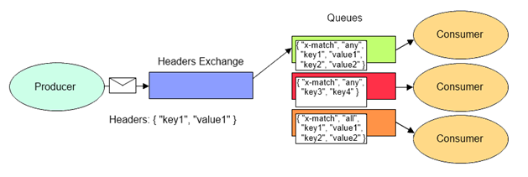
AMQP 0-9-1 Model – Headers Exchange
The Headers exchange type routes messages based upon a matching of message headers to the expected headers specified by the binding queue.
The headers exchange type is similar to the topic exchange type in that more than one criteria can be specified as a filter, but the headers exchange differs in that its criteria is expressed in the message headers as opposed to the routing key, may occur in any order, and may be specified as matching any or all of the specified headers.
The Headers exchange type is useful for directing messages which may contain a subset of known criteria where the order is not established and provides a more convenient way of matching based upon the use of complex types as the matching criteria (i.e. a serialized object).

